Slide 1
Sequential Logic

Slide 2

Remembering
All previous chips have been combinational: depend only on combination of inputs $→$ important for eg. ALU, but…
Sequential chips: memory elements that preserve data over time $→$ store and recall values
Flip-flops = building blocks $→$ binary cells, registers, memory banks, counters
Remembering is inherently time-dependent: you remember now what has been committed to memory before $→$requires a clock:

Slide 3

Remembering
All previous chips have been combinational: depend only on combination of inputs $→$ important for eg. ALU, but…
Sequential chips: memory elements that preserve data over time $→$ store and recall values
Flip-flops = building blocks $→$ binary cells, registers, memory banks, counters
Remembering is inherently time-dependent: you remember now what has been committed to memory before $→$requires a clock:

Slide 4
Remembering
All previous chips have been combinational: depend only on combination of inputs $→$ important for eg. ALU, but…
Sequential chips: memory elements that preserve data over time $→$ store and recall values
Flip-flops = building blocks $→$ binary cells, registers, memory banks, counters
Remembering is inherently time-dependent: you remember now what has been committed to memory before $→$requires a clock:
Cannot maintain state

Slide 5

Remembering
All previous chips have been combinational: depend only on combination of inputs $→$ important for eg. ALU, but…
Sequential chips: memory elements that preserve data over time $→$ store and recall values
Flip-flops = building blocks $→$ binary cells, registers, memory banks, counters
Remembering is inherently time-dependent: you remember now what has been committed to memory before $→$requires a clock:
Cannot maintain state

Slide 6

Remembering
All previous chips have been combinational: depend only on combination of inputs $→$ important for eg. ALU, but…
Sequential chips: memory elements that preserve data over time $→$ store and recall values
Flip-flops = building blocks $→$ binary cells, registers, memory banks, counters
Remembering is inherently time-dependent: you remember now what has been committed to memory before $→$requires a clock:
Cannot maintain state

Slide 7

Remembering
All previous chips have been combinational: depend only on combination of inputs $→$ important for eg. ALU, but…
Sequential chips: memory elements that preserve data over time $→$ store and recall values
Flip-flops = building blocks $→$ binary cells, registers, memory banks, counters
Remembering is inherently time-dependent: you remember now what has been committed to memory before $→$requires a clock:
Cannot maintain state

Slide 8
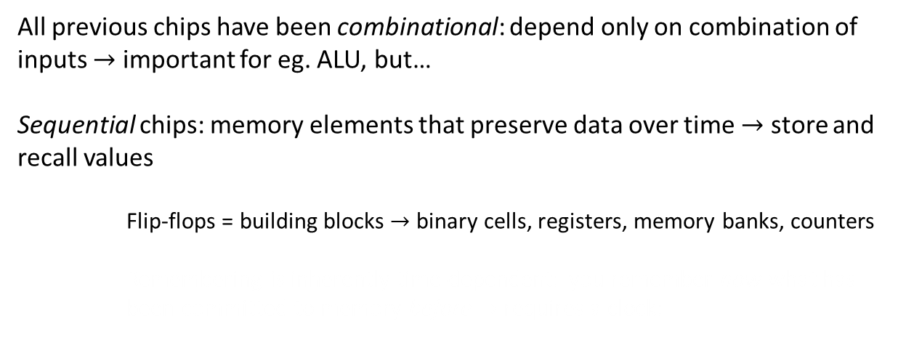
Remembering
All previous chips have been combinational: depend only on combination of inputs $→$ important for eg. ALU, but…
Sequential chips: memory elements that preserve data over time $→$ store and recall values
Flip-flops = building blocks $→$ binary cells, registers, memory banks, counters
Remembering is inherently time-dependent: you remember now what has been committed to memory before $→$requires a clock:
Cannot maintain state

Slide 9
Remembering
All previous chips have been combinational: depend only on combination of inputs $→$ important for eg. ALU, but…
Sequential chips: memory elements that preserve data over time $→$ store and recall values
Flip-flops = building blocks $→$ binary cells, registers, memory banks, counters
Remembering is inherently time-dependent: you remember now what has been committed to memory before $→$requires a clock:
Cannot maintain state
Provide memory

Slide 10
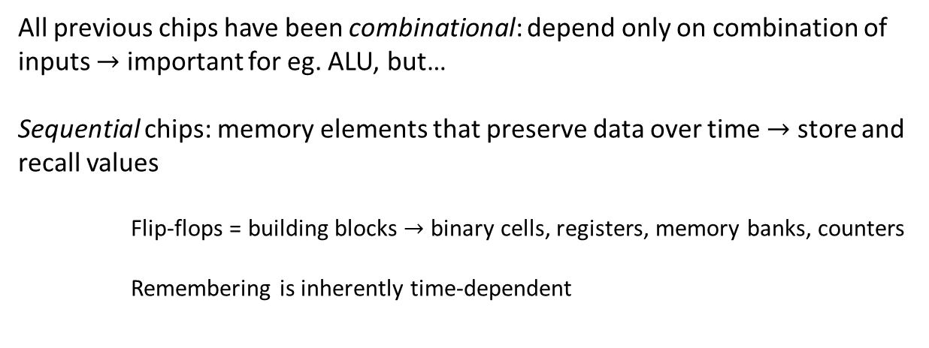
Remembering
All previous chips have been combinational: depend only on combination of inputs $→$ important for eg. ALU, but…
Sequential chips: memory elements that preserve data over time $→$ store and recall values
Flip-flops = building blocks $→$ binary cells, registers, memory banks, counters
Remembering is inherently time-dependent: you remember now what has been committed to memory before $→$requires a clock:
Cannot maintain state
Provide memory

Slide 11
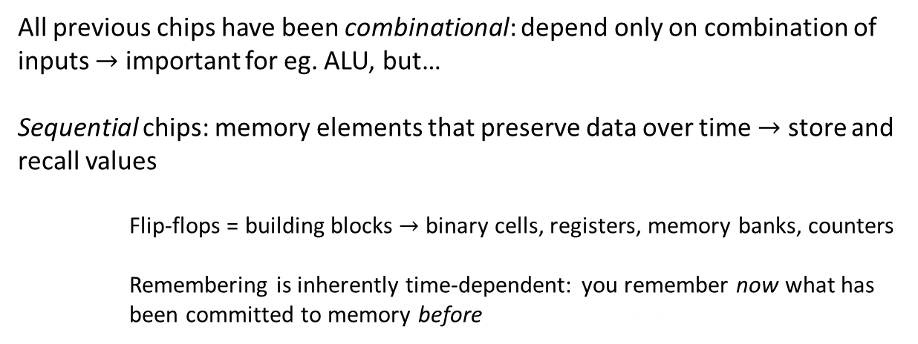
Remembering
All previous chips have been combinational: depend only on combination of inputs $→$ important for eg. ALU, but…
Sequential chips: memory elements that preserve data over time $→$ store and recall values
Flip-flops = building blocks $→$ binary cells, registers, memory banks, counters
Remembering is inherently time-dependent: you remember now what has been committed to memory before $→$requires a clock:
Cannot maintain state
Provide memory

Slide 12
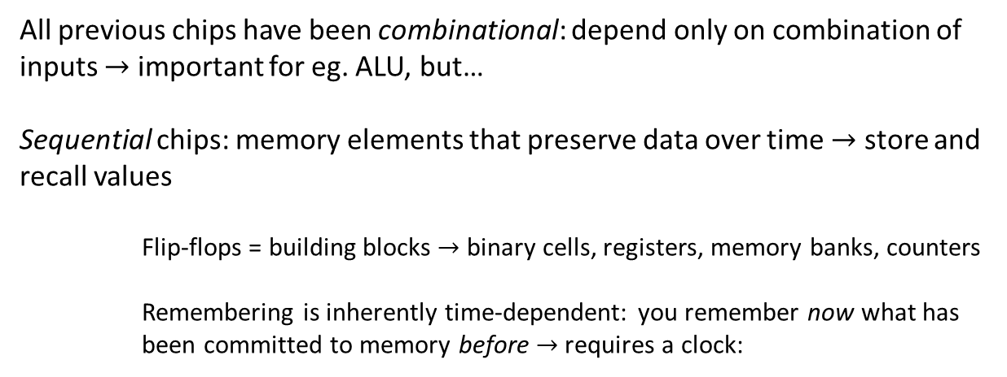
Remembering
All previous chips have been combinational: depend only on combination of inputs $→$ important for eg. ALU, but…
Sequential chips: memory elements that preserve data over time $→$ store and recall values
Flip-flops = building blocks $→$ binary cells, registers, memory banks, counters
Remembering is inherently time-dependent: you remember now what has been committed to memory before $→$requires a clock:
Cannot maintain state
Provide memory

Slide 13
Remembering
All previous chips have been combinational: depend only on combination of inputs $→$ important for eg. ALU, but…
Sequential chips: memory elements that preserve data over time $→$ store and recall values
Flip-flops = building blocks $→$ binary cells, registers, memory banks, counters
Remembering is inherently time-dependent: you remember now what has been committed to memory before $→$requires a clock:
Cannot maintain state
Provide memory
Time

Slide 14
Remembering
All previous chips have been combinational: depend only on combination of inputs $→$ important for eg. ALU, but…
Sequential chips: memory elements that preserve data over time $→$ store and recall values
Flip-flops = building blocks $→$ binary cells, registers, memory banks, counters
Remembering is inherently time-dependent: you remember now what has been committed to memory before $→$requires a clock:
Cannot maintain state
Provide memory
High – Tock – 1
Low – Tick – 0
Time

Slide 15
Remembering
All previous chips have been combinational: depend only on combination of inputs $→$ important for eg. ALU, but…
Sequential chips: memory elements that preserve data over time $→$ store and recall values
Flip-flops = building blocks $→$ binary cells, registers, memory banks, counters
Remembering is inherently time-dependent: you remember now what has been committed to memory before $→$requires a clock:
Cannot maintain state
Provide memory
High – Tock – 1
Low – Tick – 0
Time

Slide 16
Remembering
All previous chips have been combinational: depend only on combination of inputs $→$ important for eg. ALU, but…
Sequential chips: memory elements that preserve data over time $→$ store and recall values
Flip-flops = building blocks $→$ binary cells, registers, memory banks, counters
Remembering is inherently time-dependent: you remember now what has been committed to memory before $→$requires a clock:
Cannot maintain state
Provide memory
High – Tock – 1
Low – Tick – 0
Time
Cycle

Slide 17

Remembering
All previous chips have been combinational: depend only on combination of inputs $→$ important for eg. ALU, but…
Sequential chips: memory elements that preserve data over time $→$ store and recall values
Flip-flops = building blocks $→$ binary cells, registers, memory banks, counters
Remembering is inherently time-dependent: you remember now what has been committed to memory before $→$requires a clock:
Cannot maintain state
Provide memory
High – Tock – 1
Represented by binary siignal
$$↓$$
circuitry simultaneously broadcasts to every sequential chip
Low – Tick – 0
Time
Cycle

Slide 18
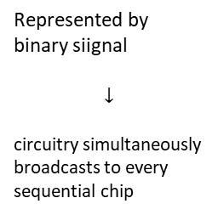
Remembering
All previous chips have been combinational: depend only on combination of inputs $→$ important for eg. ALU, but…
Sequential chips: memory elements that preserve data over time $→$ store and recall values
Flip-flops = building blocks $→$ binary cells, registers, memory banks, counters
Remembering is inherently time-dependent: you remember now what has been committed to memory before $→$requires a clock:
Cannot maintain state
Provide memory
High – Tock – 1
Represented by binary siignal
$$↓$$
circuitry simultaneously broadcasts to every sequential chip
Low – Tick – 0
Time
Cycle

Slide 19
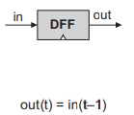

DFF
In this book we use data flip-flops (DFF) and consider them primitive
$out\left(t\right)=in(t−1)$: outputs previous input
Basis of binary cells, registers, RAM, etc.
All DFFs are connected to the same master clock $→$ “chorus”
Beginning of clock cycle: all the DFFs output previous input
Latched: changes in their inputs don’t immediately affect output
DFFs affected a billion times per second (computer´s clock frequency) simultaneaously (feeding master clock to all DFFs)

Slide 20

DFF
In this book we use data flip-flops (DFF) and consider them primitive
$out\left(t\right)=in(t−1)$: outputs previous input
Basis of binary cells, registers, RAM, etc.
All DFFs are connected to the same master clock $→$ “chorus”
Beginning of clock cycle: all the DFFs output previous input
Latched: changes in their inputs don’t immediately affect output
DFFs affected a billion times per second (computer´s clock frequency) simultaneaously (feeding master clock to all DFFs)

Slide 21

DFF
In this book we use data flip-flops (DFF) and consider them primitive
$out\left(t\right)=in(t−1)$: outputs previous input
Basis of binary cells, registers, RAM, etc.
All DFFs are connected to the same master clock $→$ “chorus”
Beginning of clock cycle: all the DFFs output previous input
Latched: changes in their inputs don’t immediately affect output
DFFs affected a billion times per second (computer´s clock frequency) simultaneaously (feeding master clock to all DFFs)

Slide 22
DFF
In this book we use data flip-flops (DFF) and consider them primitive
$out\left(t\right)=in(t−1)$: outputs previous input
Basis of binary cells, registers, RAM, etc.
All DFFs are connected to the same master clock $→$ “chorus”
Beginning of clock cycle: all the DFFs output previous input
Latched: changes in their inputs don’t immediately affect output
DFFs affected a billion times per second (computer´s clock frequency) simultaneaously (feeding master clock to all DFFs)
clock input (chip depends on time)

Slide 23

DFF
In this book we use data flip-flops (DFF) and consider them primitive
$out\left(t\right)=in(t−1)$: outputs previous input
Basis of binary cells, registers, RAM, etc.
All DFFs are connected to the same master clock $→$ “chorus”
Beginning of clock cycle: all the DFFs output previous input
Latched: changes in their inputs don’t immediately affect output
DFFs affected a billion times per second (computer´s clock frequency) simultaneaously (feeding master clock to all DFFs)
clock input (chip depends on time)

Slide 24

DFF
In this book we use data flip-flops (DFF) and consider them primitive
$out\left(t\right)=in(t−1)$: outputs previous input
Basis of binary cells, registers, RAM, etc.
All DFFs are connected to the same master clock $→$ “chorus”
Beginning of clock cycle: all the DFFs output previous input
Latched: changes in their inputs don’t immediately affect output
DFFs affected a billion times per second (computer´s clock frequency) simultaneaously (feeding master clock to all DFFs)
clock input (chip depends on time)

Slide 25
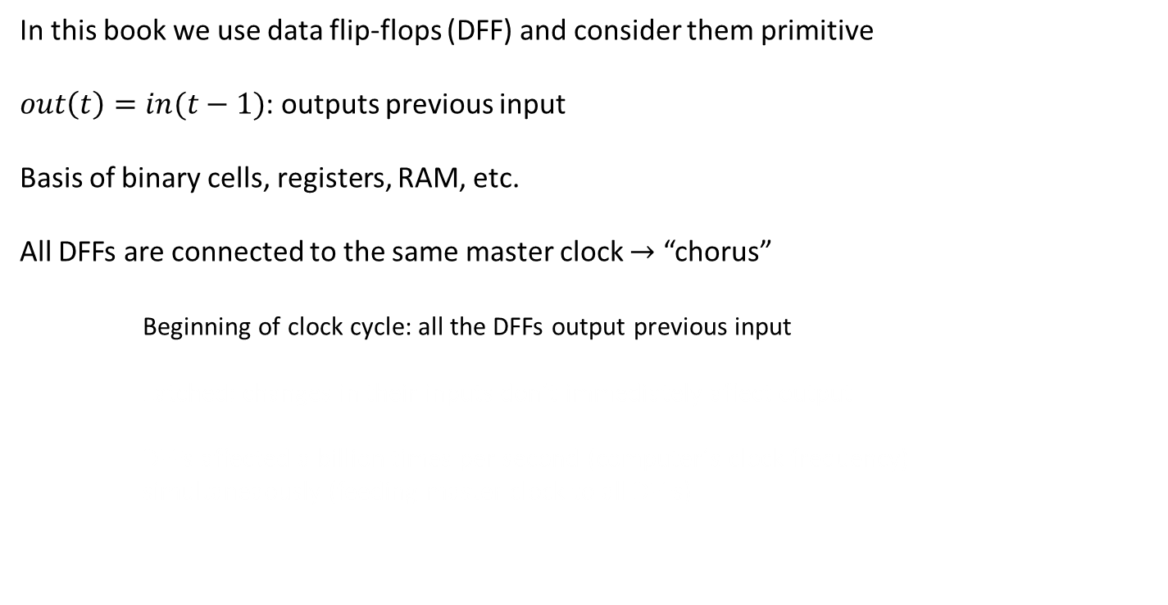
DFF
In this book we use data flip-flops (DFF) and consider them primitive
$out\left(t\right)=in(t−1)$: outputs previous input
Basis of binary cells, registers, RAM, etc.
All DFFs are connected to the same master clock $→$ “chorus”
Beginning of clock cycle: all the DFFs output previous input
Latched: changes in their inputs don’t immediately affect output
DFFs affected a billion times per second (computer´s clock frequency) simultaneaously (feeding master clock to all DFFs)
clock input (chip depends on time)

Slide 26
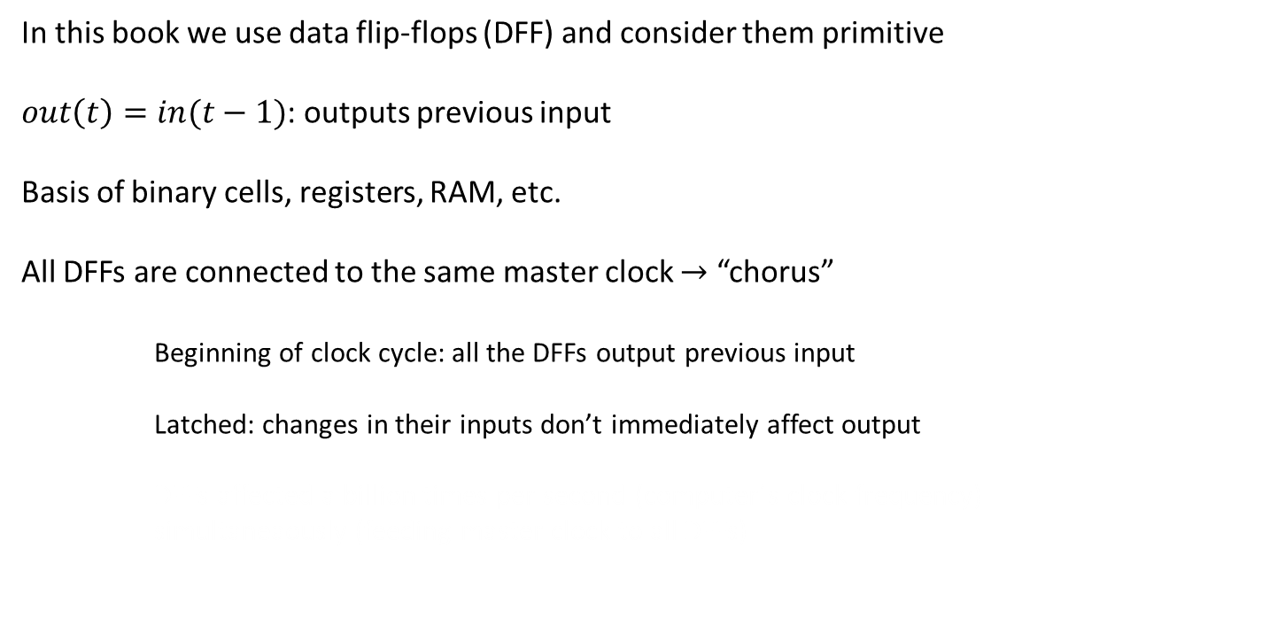
DFF
In this book we use data flip-flops (DFF) and consider them primitive
$out\left(t\right)=in(t−1)$: outputs previous input
Basis of binary cells, registers, RAM, etc.
All DFFs are connected to the same master clock $→$ “chorus”
Beginning of clock cycle: all the DFFs output previous input
Latched: changes in their inputs don’t immediately affect output
DFFs affected a billion times per second (computer´s clock frequency) simultaneaously (feeding master clock to all DFFs)
clock input (chip depends on time)

Slide 27
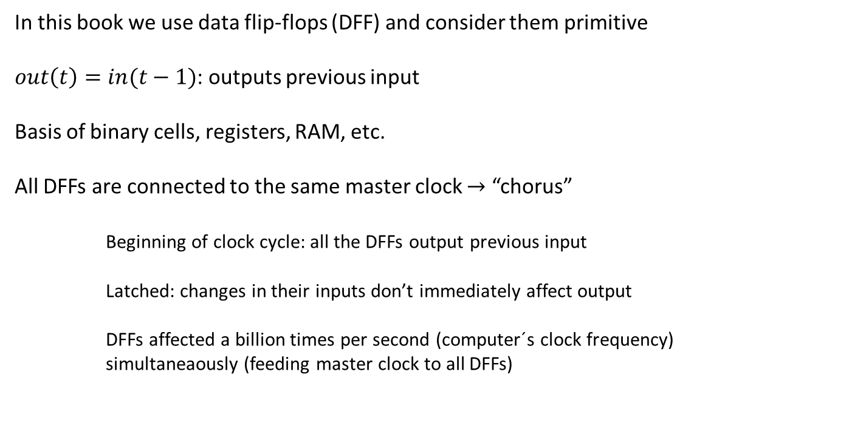
DFF
In this book we use data flip-flops (DFF) and consider them primitive
$out\left(t\right)=in(t−1)$: outputs previous input
Basis of binary cells, registers, RAM, etc.
All DFFs are connected to the same master clock $→$ “chorus”
Beginning of clock cycle: all the DFFs output previous input
Latched: changes in their inputs don’t immediately affect output
DFFs affected a billion times per second (computer´s clock frequency) simultaneaously (feeding master clock to all DFFs)
clock input (chip depends on time)

Slide 28


Registers 1-bit register
Stores a value over time
Single-bit register / bit / binary cell: stores 0 or 1
$out\left(t\right)=out(t−1)$: depends on load bit
load = 0 $→$ keep current value $→$ read
load = 1 $→$ load new value $→$ write
Multiple 1-bit registers $→$ any width of register
“word” = 16, 32, or 64 bits

Slide 29

Registers 1-bit register
Stores a value over time
Single-bit register / bit / binary cell: stores 0 or 1
$out\left(t\right)=out(t−1)$: depends on load bit
load = 0 $→$ keep current value $→$ read
load = 1 $→$ load new value $→$ write
Multiple 1-bit registers $→$ any width of register
“word” = 16, 32, or 64 bits

Slide 30

Registers 1-bit register
Stores a value over time
Single-bit register / bit / binary cell: stores 0 or 1
$out\left(t\right)$ depends on load bit
load = 0 $→$ keep current value $→$ read
load = 1 $→$ load new value $→$ write
Multiple 1-bit registers $→$ any width of register
“word” = 16, 32, or 64 bits

Slide 31
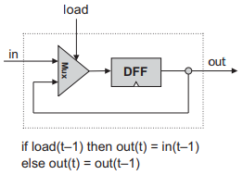

Registers 1-bit register
Stores a value over time
Single-bit register / bit / binary cell: stores 0 or 1
$out\left(t\right)$ depends on load bit
load = 0 $→$ keep current value $→$ read
load = 1 $→$ load new value $→$ write
Multiple 1-bit registers $→$ any width of register
“word” = 16, 32, or 64 bits

Slide 32

Registers 1-bit register
Stores a value over time
Single-bit register / bit / binary cell: stores 0 or 1
$out\left(t\right)$ depends on load bit
load = 0 $→$ keep current value $→$ read
load = 1 $→$ load new value $→$ write
Multiple 1-bit registers $→$ any width of register
“word” = 16, 32, or 64 bits

Slide 33
Registers 1-bit register
Stores a value over time
Single-bit register / bit / binary cell: stores 0 or 1
$out\left(t\right)$ depends on load bit
load = 0 $→$ keep current value $→$ read
load = 1 $→$ load new value $→$ write
Multiple 1-bit registers $→$ any width of register
“word” = 16, 32, or 64 bits
/**
* 1-bit register:
* If load[t] == 1 then out[t+1] = in[t]
* else out does not change (out[t+1] = out[t])
*/
CHIP Bit {
IN in, load;
OUT out;
PARTS:
Mux(a=dffout, b=in, sel=load, out=o2);
DFF(in=o2, out=dffout, out=out);
}

Slide 34
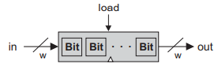
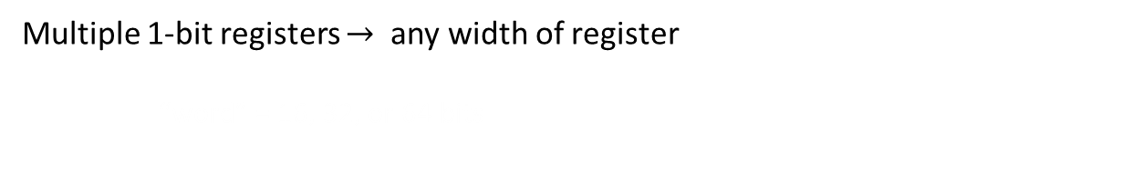
Registers multi-bit register
Multiple 1-bit registers $→$ any width of register
“word” = 16, 32, or 64 bits

Slide 35
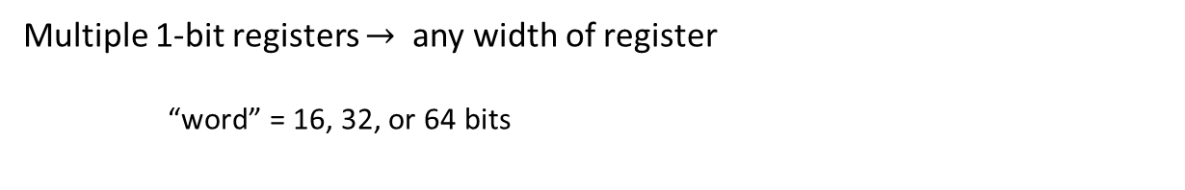
Registers multi-bit register
Multiple 1-bit registers $→$ any width of register
“word” = 16, 32, or 64 bits

Slide 36
Registers multi-bit register
Multiple 1-bit registers $→$ any width of register
“word” = 16, 32, or 64 bits
/**
* 16-bit register:
* If load[t] == 1 then out[t+1] = in[t]
* else out does not change
*/
CHIP Register {
IN in[16], load;
OUT out[16];
PARTS:
Bit(in=in[0], load=load, out=out[0]);
Bit(in=in[1], load=load, out=out[1]);
Bit(in=in[2], load=load, out=out[2]);
Bit(in=in[3], load=load, out=out[3]);
Bit(in=in[4], load=load, out=out[4]);
Bit(in=in[5], load=load, out=out[5]);
Bit(in=in[6], load=load, out=out[6]);
Bit(in=in[7], load=load, out=out[7]);
Bit(in=in[8], load=load, out=out[8]);
Bit(in=in[9], load=load, out=out[9]);
Bit(in=in[10], load=load, out=out[10]);
Bit(in=in[11], load=load, out=out[11]);
Bit(in=in[12], load=load, out=out[12]);
Bit(in=in[13], load=load, out=out[13]);
Bit(in=in[14], load=load, out=out[14]);
Bit(in=in[15], load=load, out=out[15]);
}

Slide 37

Registers multi-bit register
Multiple 1-bit registers $→$ any width of register
“word” = 16, 32, or 64 bits
/**
* 16-bit register:
* If load[t] == 1 then out[t+1] = in[t]
* else out does not change
*/
CHIP Register {
IN in[16], load;
OUT out[16];
PARTS:
Bit(in=in[0], load=load, out=out[0]);
Bit(in=in[1], load=load, out=out[1]);
Bit(in=in[2], load=load, out=out[2]);
Bit(in=in[3], load=load, out=out[3]);
Bit(in=in[4], load=load, out=out[4]);
Bit(in=in[5], load=load, out=out[5]);
Bit(in=in[6], load=load, out=out[6]);
Bit(in=in[7], load=load, out=out[7]);
Bit(in=in[8], load=load, out=out[8]);
Bit(in=in[9], load=load, out=out[9]);
Bit(in=in[10], load=load, out=out[10]);
Bit(in=in[11], load=load, out=out[11]);
Bit(in=in[12], load=load, out=out[12]);
Bit(in=in[13], load=load, out=out[13]);
Bit(in=in[14], load=load, out=out[14]);
Bit(in=in[15], load=load, out=out[15]);
}

Slide 38
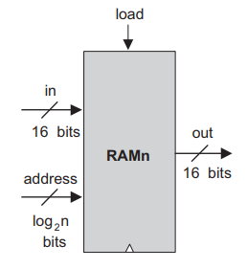
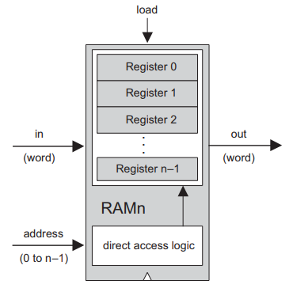

RAM multi registers
Stack registers $→$ memory bank of any length
Random Access Memory
Directly access randomly chosen words irrespective of its physical location in equal speed
For n-register RAM
Stack n registers
Assign unique address (j = 0 – n-1)
Build gate logic to select register at address j
3 inputs: data input, address input, and load bit
load = 0 $→$ read: RAM outputs value of selected register
load = 1 $→$ write: commit input value to register $→$ RAM will start
emitting in next time unit
basic RAM design
width: width of their words eg. 32 or 64 bits
size: number of words eg. hundreds of millions

Slide 39

RAM multi registers
Stack registers $→$ memory bank of any length
Random Access Memory
Directly access randomly chosen words irrespective of its physical location in equal speed
For n-register RAM
Stack n registers
Assign unique address (j = 0 – n-1)
Build gate logic to select register at address j
3 inputs: data input, address input, and load bit
load = 0 $→$ read: RAM outputs value of selected register
load = 1 $→$ write: commit input value to register $→$ RAM will start
emitting in next time unit
basic RAM design
width: width of their words eg. 32 or 64 bits
size: number of words eg. hundreds of millions

Slide 40

RAM multi registers
Stack registers $→$ memory bank of any length
Random Access Memory
Directly access randomly chosen words irrespective of its physical location in equal speed
For n-register RAM
Stack n registers
Assign unique address (j = 0 – n-1)
Build gate logic to select register at address j
3 inputs: data input, address input, and load bit
load = 0 $→$ read: RAM outputs value of selected register
load = 1 $→$ write: commit input value to register $→$ RAM will start
emitting in next time unit
basic RAM design
width: width of their words eg. 32 or 64 bits
size: number of words eg. hundreds of millions

Slide 41

RAM multi registers
Stack registers $→$ memory bank of any length
Random Access Memory
Directly access randomly chosen words irrespective of its physical location in equal speed
For n-register RAM
Stack n registers
Assign unique address (j = 0 – n-1)
Build gate logic to select register at address j
3 inputs: data input, address input, and load bit
load = 0 $→$ read: RAM outputs value of selected register
load = 1 $→$ write: commit input value to register $→$ RAM will start
emitting in next time unit
basic RAM design
width: width of their words eg. 32 or 64 bits
size: number of words eg. hundreds of millions

Slide 42
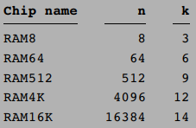

RAM multi registers
Stack registers $→$ memory bank of any length
Random Access Memory
Directly access randomly chosen words irrespective of its physical location in equal speed
For n-register RAM
Stack n registers
Assign unique address (k = 0 – n-1)
Build gate logic to select register at address k
3 inputs: data input, address input, and load bit
load = 0 $→$ read: RAM outputs value of selected register
load = 1 $→$ write: commit input value to register $→$ RAM will start
emitting in next time unit
basic RAM design
width: width of their words eg. 32 or 64 bits
size: number of words eg. hundreds of millions

Slide 43

RAM multi registers
Stack registers $→$ memory bank of any length
Random Access Memory
Directly access randomly chosen words irrespective of its physical location in equal speed
For n-register RAM
Stack n registers
Assign unique address (k = 0 – n-1)
Build gate logic to select register at address k
3 inputs: data input, address input, and load bit
load = 0 $→$ read: RAM outputs value of selected register
load = 1 $→$ write: commit input value to register $→$ RAM will start
emitting in next time unit
basic RAM design
width: width of their words eg. 32 or 64 bits
size: number of words eg. hundreds of millions

Slide 44
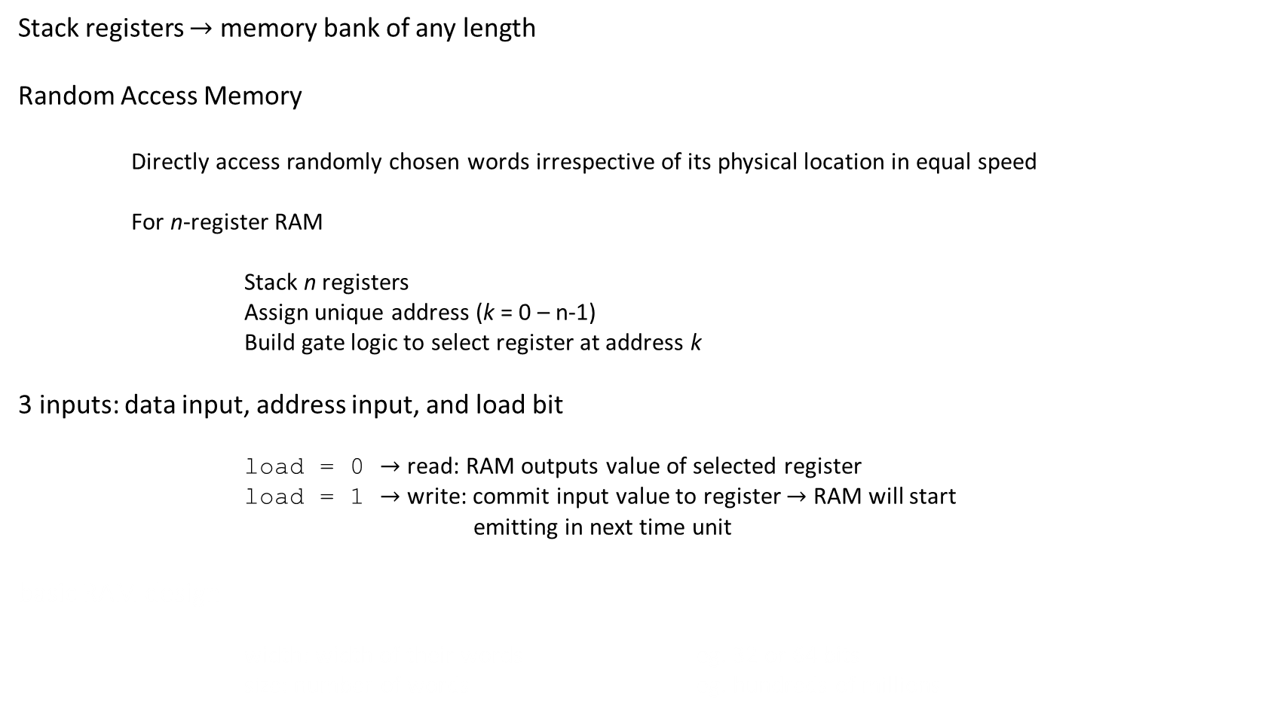
RAM multi registers
Stack registers $→$ memory bank of any length
Random Access Memory
Directly access randomly chosen words irrespective of its physical location in equal speed
For n-register RAM
Stack n registers
Assign unique address (k = 0 – n-1)
Build gate logic to select register at address k
3 inputs: data input, address input, and load bit
load = 0 $→$ read: RAM outputs value of selected register
load = 1 $→$ write: commit input value to register $→$ RAM will start
emitting in next time unit
basic RAM design
width: width of their words eg. 32 or 64 bits
size: number of words eg. hundreds of millions

Slide 45
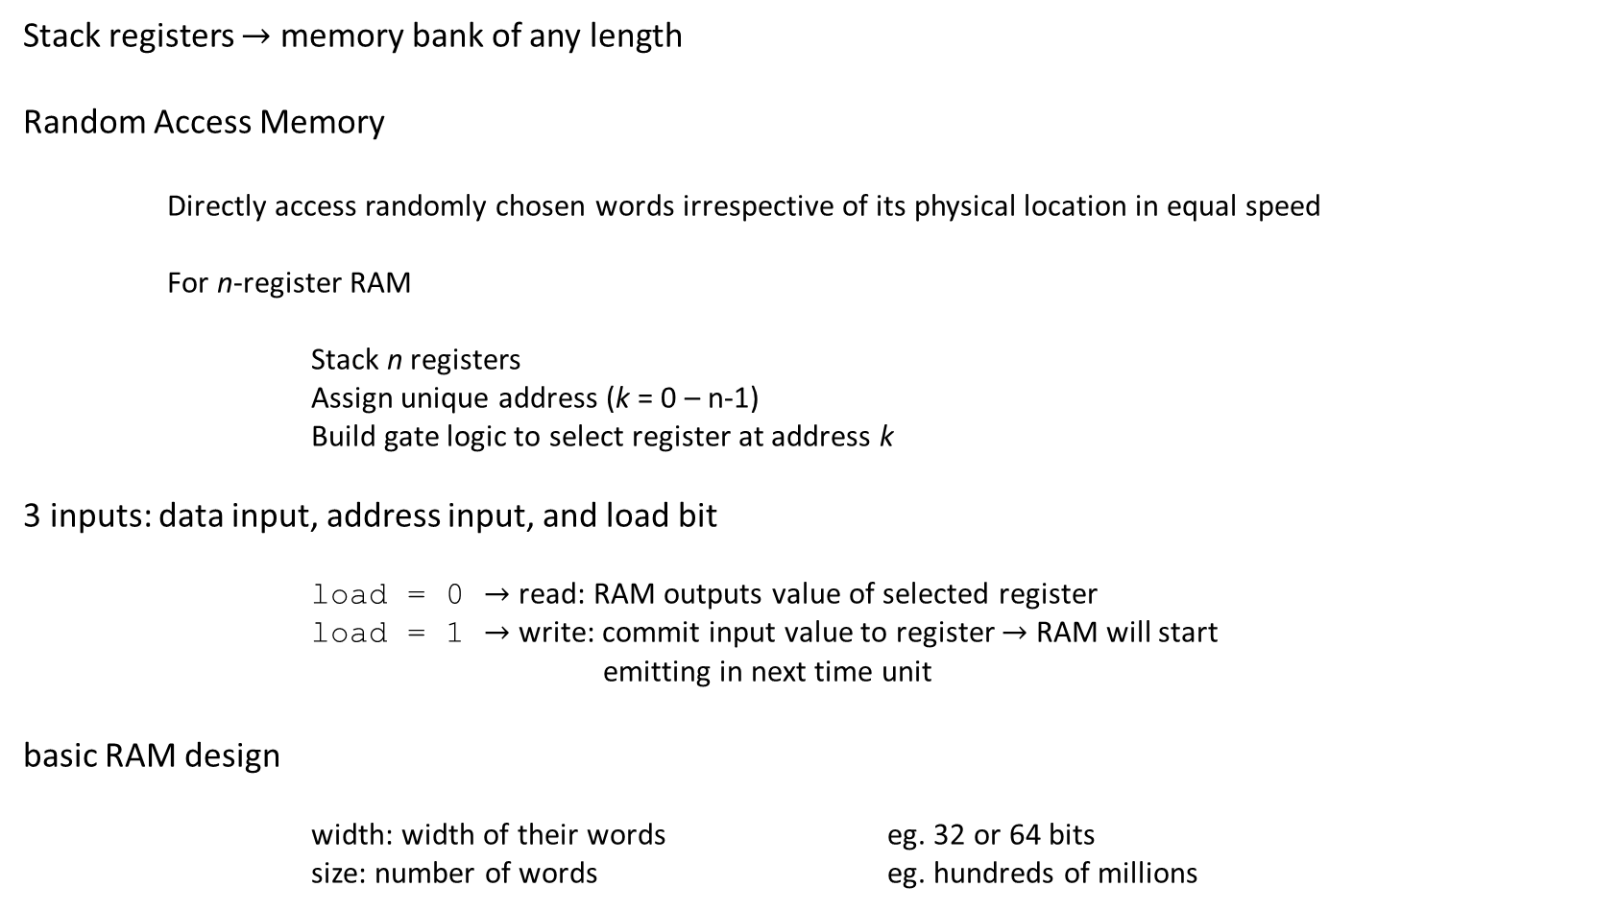
RAM multi registers
Stack registers $→$ memory bank of any length
Random Access Memory
Directly access randomly chosen words irrespective of its physical location in equal speed
For n-register RAM
Stack n registers
Assign unique address (k = 0 – n-1)
Build gate logic to select register at address k
3 inputs: data input, address input, and load bit
load = 0 $→$ read: RAM outputs value of selected register
load = 1 $→$ write: commit input value to register $→$ RAM will start
emitting in next time unit
basic RAM design
width: width of their words eg. 32 or 64 bits
size: number of words eg. hundreds of millions

Slide 46
RAM ram8
Using Ch1 and Ch 3 gates
Build combinational logic that, given a certain address value, takes the RAM8’s in input and loads it into the selected register
Line up an array of eight registers
Build combinational logic that, given a certain address value, selects the right register and pipes its out value to the RAM8’s out

Slide 47
RAM ram8
Using Ch1 and Ch 3 gates
Build combinational logic that, given a certain address value, takes the RAM8’s in input and loads it into the selected register
Line up an array of eight registers
Build combinational logic that, given a certain address value, selects the right register and pipes its out value to the RAM8’s out

Slide 48
RAM ram8
Using Ch1 and Ch 3 gates
Build combinational logic that, given a certain address value, takes the RAM8’s in input and loads it into the selected register
Line up an array of 8 registers
Build combinational logic that, given a certain address value, selects the right register and pipes its out value to the RAM8’s out

Slide 49
RAM ram8
Using Ch1 and Ch 3 gates
Build combinational logic that, given a certain address value, takes the RAM8’s in input and loads it into the selected register
Line up an array of 8 registers
Build combinational logic that, given a certain address value, selects the right register and pipes its out value to the RAM8’s out

Slide 50
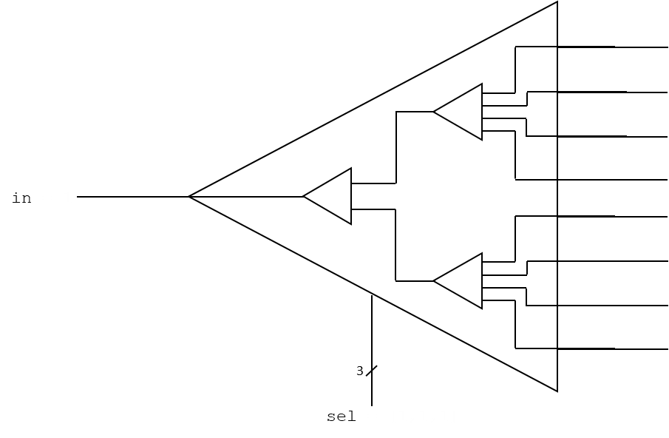
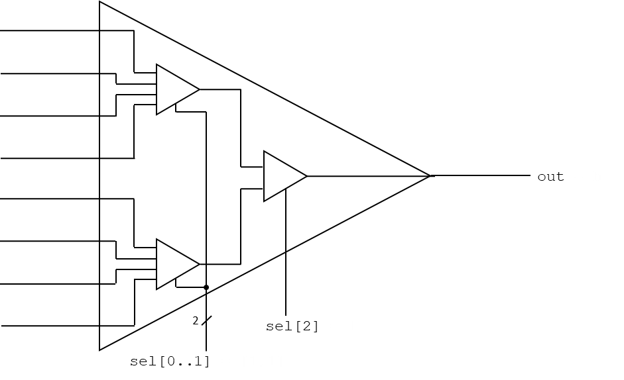
RAM ram8
Using Ch1 and Ch 3 gates
Build combinational logic that, given a certain address value, takes the RAM8’s in input and loads it into the selected register
Line up an array of 8 registers
Build combinational logic that, given a certain address value, selects the right register and pipes its out value to the RAM8’s out
/**
* Memory of 8 registers, each 16 bit-wide. Out holds the value
* stored at the memory location specified by address. If load==1, then
* the in value is loaded into the memory location specified by address
* (the loaded value will be emitted to out from the next time step onward).
*/
CHIP RAM8 {
IN in[16], load, address[3];
OUT out[16];
PARTS:
DMux8Way(in=load, sel=address, a=load0, b=load1, c=load2, d=load3, e=load4, f=load5, g=load6, h=load7);
Register(in=in, load=load0, out=o0);
Register(in=in, load=load1, out=o1);
Register(in=in, load=load2, out=o2);
Register(in=in, load=load3, out=o3);
Register(in=in, load=load4, out=o4);
Register(in=in, load=load5, out=o5);
Register(in=in, load=load6, out=o6);
Register(in=in, load=load7, out=o7);
Mux8Way16(a=o0, b=o1, c=o2, d=o3, e=o4, f=o5, g=o6, h=o7, sel=address, out=out);
}

Slide 51
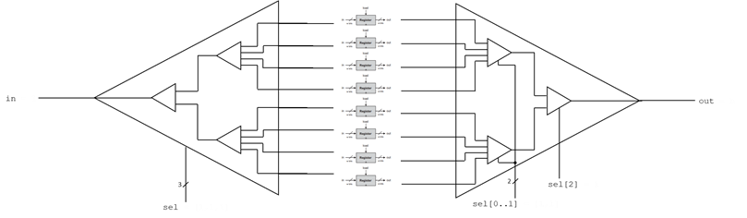
RAM ram8
Using Ch1 and Ch 3 gates
Build combinational logic that, given a certain address value, takes the RAM8’s in input and loads it into the selected register
Line up an array of 8 registers
Build combinational logic that, given a certain address value, selects the right register and pipes its out value to the RAM8’s out
/**
* Memory of 8 registers, each 16 bit-wide. Out holds the value
* stored at the memory location specified by address. If load==1, then
* the in value is loaded into the memory location specified by address
* (the loaded value will be emitted to out from the next time step onward).
*/
CHIP RAM8 {
IN in[16], load, address[3];
OUT out[16];
PARTS:
DMux8Way(in=load, sel=address, a=load0, b=load1, c=load2, d=load3, e=load4, f=load5, g=load6, h=load7);
Register(in=in, load=load0, out=o0);
Register(in=in, load=load1, out=o1);
Register(in=in, load=load2, out=o2);
Register(in=in, load=load3, out=o3);
Register(in=in, load=load4, out=o4);
Register(in=in, load=load5, out=o5);
Register(in=in, load=load6, out=o6);
Register(in=in, load=load7, out=o7);
Mux8Way16(a=o0, b=o1, c=o2, d=o3, e=o4, f=o5, g=o6, h=o7, sel=address, out=out);
}

Slide 52
RAM ram8
Using Ch1 and Ch 3 gates
Build combinational logic that, given a certain address value, takes the RAM8’s in input and loads it into the selected register
Line up an array of 8 registers
Build combinational logic that, given a certain address value, selects the right register and pipes its out value to the RAM8’s out
/**
* Memory of 8 registers, each 16 bit-wide. Out holds the value
* stored at the memory location specified by address. If load==1, then
* the in value is loaded into the memory location specified by address
* (the loaded value will be emitted to out from the next time step onward).
*/
CHIP RAM8 {
IN in[16], load, address[3];
OUT out[16];
PARTS:
DMux8Way(in=load, sel=address, a=load0, b=load1, c=load2, d=load3, e=load4, f=load5, g=load6, h=load7);
Register(in=in, load=load0, out=o0);
Register(in=in, load=load1, out=o1);
Register(in=in, load=load2, out=o2);
Register(in=in, load=load3, out=o3);
Register(in=in, load=load4, out=o4);
Register(in=in, load=load5, out=o5);
Register(in=in, load=load6, out=o6);
Register(in=in, load=load7, out=o7);
Mux8Way16(a=o0, b=o1, c=o2, d=o3, e=o4, f=o5, g=o6, h=o7, sel=address, out=out);
}

Slide 53
RAM ram8
Using Ch1 and Ch 3 gates
Build combinational logic that, given a certain address value, takes the RAM8’s in input and loads it into the selected register
Line up an array of 8 registers
Build combinational logic that, given a certain address value, selects the right register and pipes its out value to the RAM8’s out
/**
* Memory of 8 registers, each 16 bit-wide. Out holds the value
* stored at the memory location specified by address. If load==1, then
* the in value is loaded into the memory location specified by address
* (the loaded value will be emitted to out from the next time step onward).
*/
CHIP RAM8 {
IN in[16], load, address[3];
OUT out[16];
PARTS:
DMux8Way(in=load, sel=address, a=load0, b=load1, c=load2, d=load3, e=load4, f=load5, g=load6, h=load7);
Register(in=in, load=load0, out=o0);
Register(in=in, load=load1, out=o1);
Register(in=in, load=load2, out=o2);
Register(in=in, load=load3, out=o3);
Register(in=in, load=load4, out=o4);
Register(in=in, load=load5, out=o5);
Register(in=in, load=load6, out=o6);
Register(in=in, load=load7, out=o7);
Mux8Way16(a=o0, b=o1, c=o2, d=o3, e=o4, f=o5, g=o6, h=o7, sel=address, out=out);
}

Slide 54
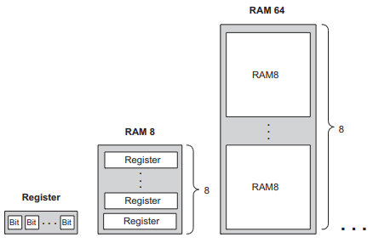
RAM ram64
A memory bank of arbitrary length (a power of 2) is built recursively from smaller memory units (registers all the way down)
Eg. 64-register RAM can be built from an array of eight 8-register RAM chips
In RAM64, we use a 6-bit address xxxyyy
The MSB xxx bits select one of the RAM8 chips, and the LSB yyy bits select one of the registers within the selected RAM8.

Slide 55
RAM ram64
A memory bank of arbitrary length (a power of 2) is built recursively from smaller memory units (registers all the way down)
Eg. 64-register RAM can be built from an array of eight 8-register RAM chips
In RAM64, we use a 6-bit address xxxyyy
The MSB xxx bits select one of the RAM8 chips, and the LSB yyy bits select one of the registers within the selected RAM8.

Slide 56
RAM ram64
A memory bank of arbitrary length (a power of 2) is built recursively from smaller memory units (registers all the way down)
Eg. 64-register RAM can be built from an array of eight 8-register RAM chips
In RAM64, we use a 6-bit address xxxyyy
The MSB xxx bits select one of the RAM8 chips, and the LSB yyy bits select one of the registers within the selected RAM8.

Slide 57
RAM ram64
A memory bank of arbitrary length (a power of 2) is built recursively from smaller memory units (registers all the way down)
Eg. 64-register RAM can be built from an array of eight 8-register RAM chips
In RAM64, we use a 6-bit address xxxyyy
The MSB xxx bits select one of the RAM8 chips, and the LSB yyy bits select one of the registers within the selected RAM8.

Slide 58
RAM ram64
A memory bank of arbitrary length (a power of 2) is built recursively from smaller memory units (registers all the way down)
Eg. 64-register RAM can be built from an array of eight 8-register RAM chips
In RAM64, we use a 6-bit address xxxyyy
The MSB xxx bits select one of the RAM8 chips, and the LSB yyy bits select one of the registers within the selected RAM8.
/**
* Memory of 64 registers, each 16 bit-wide. Out holds the value
* stored at the memory location specified by address. If load==1, then
* the in value is loaded into the memory location specified by address
* (the loaded value will be emitted to out from the next time step onward).
*/
CHIP RAM64 {
IN in[16], load, address[6];
OUT out[16];
PARTS:
DMux8Way(in=load, sel=address[0..2], a=load0, b=load1, c=load2, d=load3, e=load4, f=load5, g=load6, h=load7);
RAM8(in=in, load=load0, address=address[3..5], out=o0);
RAM8(in=in, load=load1, address=address[3..5], out=o1);
RAM8(in=in, load=load2, address=address[3..5], out=o2);
RAM8(in=in, load=load3, address=address[3..5], out=o3);
RAM8(in=in, load=load4, address=address[3..5], out=o4);
RAM8(in=in, load=load5, address=address[3..5], out=o5);
RAM8(in=in, load=load6, address=address[3..5], out=o6);
RAM8(in=in, load=load7, address=address[3..5], out=o7);
Mux8Way16(a=o0, b=o1, c=o2, d=o3, e=o4, f=o5, g=o6, h=o7, sel=address[0..2], out=out);
}

Slide 59
RAM ram64
A memory bank of arbitrary length (a power of 2) is built recursively from smaller memory units (registers all the way down)
Eg. 64-register RAM can be built from an array of eight 8-register RAM chips
In RAM64, we use a 6-bit address xxxyyy
The MSB xxx bits select one of the RAM8 chips, and the LSB yyy bits select one of the registers within the selected RAM8.
/**
* Memory of 64 registers, each 16 bit-wide. Out holds the value
* stored at the memory location specified by address. If load==1, then
* the in value is loaded into the memory location specified by address
* (the loaded value will be emitted to out from the next time step onward).
*/
CHIP RAM64 {
IN in[16], load, address[6];
OUT out[16];
PARTS:
DMux8Way(in=load, sel=address[0..2], a=load0, b=load1, c=load2, d=load3, e=load4, f=load5, g=load6, h=load7);
RAM8(in=in, load=load0, address=address[3..5], out=o0);
RAM8(in=in, load=load1, address=address[3..5], out=o1);
RAM8(in=in, load=load2, address=address[3..5], out=o2);
RAM8(in=in, load=load3, address=address[3..5], out=o3);
RAM8(in=in, load=load4, address=address[3..5], out=o4);
RAM8(in=in, load=load5, address=address[3..5], out=o5);
RAM8(in=in, load=load6, address=address[3..5], out=o6);
RAM8(in=in, load=load7, address=address[3..5], out=o7);
Mux8Way16(a=o0, b=o1, c=o2, d=o3, e=o4, f=o5, g=o6, h=o7, sel=address[0..2], out=out);
}

Slide 60
RAM ram64
A memory bank of arbitrary length (a power of 2) is built recursively from smaller memory units (registers all the way down)
Eg. 64-register RAM can be built from an array of eight 8-register RAM chips
In RAM64, we use a 6-bit address xxxyyy
The MSB xxx bits select one of the RAM8 chips, and the LSB yyy bits select one of the registers within the selected RAM8.
/**
* Memory of 64 registers, each 16 bit-wide. Out holds the value
* stored at the memory location specified by address. If load==1, then
* the in value is loaded into the memory location specified by address
* (the loaded value will be emitted to out from the next time step onward).
*/
CHIP RAM64 {
IN in[16], load, address[6];
OUT out[16];
PARTS:
DMux8Way(in=load, sel=address[0..2], a=load0, b=load1, c=load2, d=load3, e=load4, f=load5, g=load6, h=load7);
RAM8(in=in, load=load0, address=address[3..5], out=o0);
RAM8(in=in, load=load1, address=address[3..5], out=o1);
RAM8(in=in, load=load2, address=address[3..5], out=o2);
RAM8(in=in, load=load3, address=address[3..5], out=o3);
RAM8(in=in, load=load4, address=address[3..5], out=o4);
RAM8(in=in, load=load5, address=address[3..5], out=o5);
RAM8(in=in, load=load6, address=address[3..5], out=o6);
RAM8(in=in, load=load7, address=address[3..5], out=o7);
Mux8Way16(a=o0, b=o1, c=o2, d=o3, e=o4, f=o5, g=o6, h=o7, sel=address[0..2], out=out);
}

Slide 61
RAM ram64
A memory bank of arbitrary length (a power of 2) is built recursively from smaller memory units (registers all the way down)
Eg. 64-register RAM can be built from an array of eight 8-register RAM chips
In RAM64, we use a 6-bit address xxxyyy
The MSB xxx bits select one of the RAM8 chips, and the LSB yyy bits select one of the registers within the selected RAM8.
/**
* Memory of 64 registers, each 16 bit-wide. Out holds the value
* stored at the memory location specified by address. If load==1, then
* the in value is loaded into the memory location specified by address
* (the loaded value will be emitted to out from the next time step onward).
*/
CHIP RAM64 {
IN in[16], load, address[6];
OUT out[16];
PARTS:
DMux8Way(in=load, sel=address[0..2], a=load0, b=load1, c=load2, d=load3, e=load4, f=load5, g=load6, h=load7);
RAM8(in=in, load=load0, address=address[3..5], out=o0);
RAM8(in=in, load=load1, address=address[3..5], out=o1);
RAM8(in=in, load=load2, address=address[3..5], out=o2);
RAM8(in=in, load=load3, address=address[3..5], out=o3);
RAM8(in=in, load=load4, address=address[3..5], out=o4);
RAM8(in=in, load=load5, address=address[3..5], out=o5);
RAM8(in=in, load=load6, address=address[3..5], out=o6);
RAM8(in=in, load=load7, address=address[3..5], out=o7);
Mux8Way16(a=o0, b=o1, c=o2, d=o3, e=o4, f=o5, g=o6, h=o7, sel=address[0..2], out=out);
}

Slide 62
RAM ram64
A memory bank of arbitrary length (a power of 2) is built recursively from smaller memory units (registers all the way down)
Eg. 64-register RAM can be built from an array of eight 8-register RAM chips
In RAM64, we use a 6-bit address xxxyyy
The MSB xxx bits select one of the RAM8 chips, and the LSB yyy bits select one of the registers within the selected RAM8.
/**
* Memory of 64 registers, each 16 bit-wide. Out holds the value
* stored at the memory location specified by address. If load==1, then
* the in value is loaded into the memory location specified by address
* (the loaded value will be emitted to out from the next time step onward).
*/
CHIP RAM64 {
IN in[16], load, address[6];
OUT out[16];
PARTS:
DMux8Way(in=load, sel=address[0..2], a=load0, b=load1, c=load2, d=load3, e=load4, f=load5, g=load6, h=load7);
RAM8(in=in, load=load0, address=address[3..5], out=o0);
RAM8(in=in, load=load1, address=address[3..5], out=o1);
RAM8(in=in, load=load2, address=address[3..5], out=o2);
RAM8(in=in, load=load3, address=address[3..5], out=o3);
RAM8(in=in, load=load4, address=address[3..5], out=o4);
RAM8(in=in, load=load5, address=address[3..5], out=o5);
RAM8(in=in, load=load6, address=address[3..5], out=o6);
RAM8(in=in, load=load7, address=address[3..5], out=o7);
Mux8Way16(a=o0, b=o1, c=o2, d=o3, e=o4, f=o5, g=o6, h=o7, sel=address[0..2], out=out);
}

Slide 63
RAM ram512
RAM512
/**
* Memory of 512 registers, each 16 bit-wide. Out holds the value
* stored at the memory location specified by address. If load==1, then
* the in value is loaded into the memory location specified by address
* (the loaded value will be emitted to out from the next time step onward).
*/
CHIP RAM512 {
IN in[16], load, address[9];
OUT out[16];
PARTS:
DMux8Way(in=load, sel=address[0..2], a=load0, b=load1, c=load2, d=load3, e=load4, f=load5, g=load6, h=load7);
RAM64(in=in, load=load0, address=address[3..8], out=o0);
RAM64(in=in, load=load1, address=address[3..8], out=o1);
RAM64(in=in, load=load2, address=address[3..8], out=o2);
RAM64(in=in, load=load3, address=address[3..8], out=o3);
RAM64(in=in, load=load4, address=address[3..8], out=o4);
RAM64(in=in, load=load5, address=address[3..8], out=o5);
RAM64(in=in, load=load6, address=address[3..8], out=o6);
RAM64(in=in, load=load7, address=address[3..8], out=o7);
Mux8Way16(a=o0, b=o1, c=o2, d=o3, e=o4, f=o5, g=o6, h=o7, sel=address[0..2], out=out);
}

Slide 64
RAM ram4k
RAM4K
/**
* Memory of 4K registers, each 16 bit-wide. Out holds the value
* stored at the memory location specified by address. If load==1, then
* the in value is loaded into the memory location specified by address
* (the loaded value will be emitted to out from the next time step onward).
*/
CHIP RAM4K {
IN in[16], load, address[12];
OUT out[16];
PARTS:
DMux8Way(in=load, sel=address[0..2], a=load0, b=load1, c=load2, d=load3, e=load4, f=load5, g=load6, h=load7);
RAM512(in=in, load=load0, address=address[3..11], out=o0);
RAM512(in=in, load=load1, address=address[3..11], out=o1);
RAM512(in=in, load=load2, address=address[3..11], out=o2);
RAM512(in=in, load=load3, address=address[3..11], out=o3);
RAM512(in=in, load=load4, address=address[3..11], out=o4);
RAM512(in=in, load=load5, address=address[3..11], out=o5);
RAM512(in=in, load=load6, address=address[3..11], out=o6);
RAM512(in=in, load=load7, address=address[3..11], out=o7);
Mux8Way16(a=o0, b=o1, c=o2, d=o3, e=o4, f=o5, g=o6, h=o7, sel=address[0..2], out=out);
}

Slide 65
RAM ram16k
RAM512
/**
* Memory of 16K registers, each 16 bit-wide. Out holds the value
* stored at the memory location specified by address. If load==1, then
* the in value is loaded into the memory location specified by address
* (the loaded value will be emitted to out from the next time step onward).
*/
CHIP RAM16K {
IN in[16], load, address[14];
OUT out[16];
PARTS:
DMux4Way(in=load, sel=address[0..1], a=load0, b=load1, c=load2, d=load3);
RAM4K(in=in, load=load0, address=address[2..13], out=o0);
RAM4K(in=in, load=load1, address=address[2..13], out=o1);
RAM4K(in=in, load=load2, address=address[2..13], out=o2);
RAM4K(in=in, load=load3, address=address[2..13], out=o3);
Mux4Way16(a=o0, b=o1, c=o2, d=o3, sel=address[0..1], out=out);
}

Slide 66

Counter
A counter is a sequential chip whose state is an integer number that increments every time unit
$out\left(t\right)=out\left(t−1\right)+c$ where usually $c=1$
A program counter outputs the address of the instruction in the current program
Usually, the counter has to increment itself by 1 in each clock cycle $→$ computer fetches the next instruction
Sometimes, ‘‘jump to execute instruction number n’’: set the counter to n $→$ continue counting with n+1, n+2, etc.
Reset the counter
Resetting to 0 restarts the program
Also, allow for decrementing instead of incrementing

Slide 67

Counter
A counter is a sequential chip whose state is an integer number that increments every time unit
$out\left(t\right)=out\left(t−1\right)+c$ where usually $c=1$
A program counter outputs the address of the instruction in the current program
Usually, the counter has to increment itself by 1 in each clock cycle $→$ computer fetches the next instruction
Sometimes, ‘‘jump to execute instruction number n’’: set the counter to n $→$ continue counting with n+1, n+2, etc.
Reset the counter
Resetting to 0 restarts the program
Also, allow for decrementing instead of incrementing

Slide 68

Counter
A counter is a sequential chip whose state is an integer number that increments every time unit
$out\left(t\right)=out\left(t−1\right)+c$ where usually $c=1$
A program counter outputs the address of the instruction in the current program
Usually, the counter has to increment itself by 1 in each clock cycle $→$ computer fetches the next instruction
Sometimes, ‘‘jump to execute instruction number n’’: set the counter to n $→$ continue counting with n+1, n+2, etc.
Reset the counter
Resetting to 0 restarts the program
Also, allow for decrementing instead of incrementing

Slide 69

Counter
A counter is a sequential chip whose state is an integer number that increments every time unit
$out\left(t\right)=out\left(t−1\right)+c$ where usually $c=1$
A program counter outputs the address of the instruction in the current program
Usually, the counter has to increment itself by 1 in each clock cycle $→$ computer fetches the next instruction
Sometimes, ‘‘jump to execute instruction number n’’: set the counter to n $→$ continue counting with n+1, n+2, etc.
Reset the counter
Resetting to 0 restarts the program
Also, allow for decrementing instead of incrementing

Slide 70

Counter
A counter is a sequential chip whose state is an integer number that increments every time unit
$out\left(t\right)=out\left(t−1\right)+c$ where usually $c=1$
A program counter outputs the address of the instruction in the current program
Usually, the counter has to increment itself by 1 in each clock cycle $→$ computer fetches the next instruction
Sometimes, ‘‘jump to execute instruction number n’’: set the counter to n $→$ continue counting with n+1, n+2, etc.
Reset the counter
Resetting to 0 restarts the program
Also, allow for decrementing instead of incrementing

Slide 71
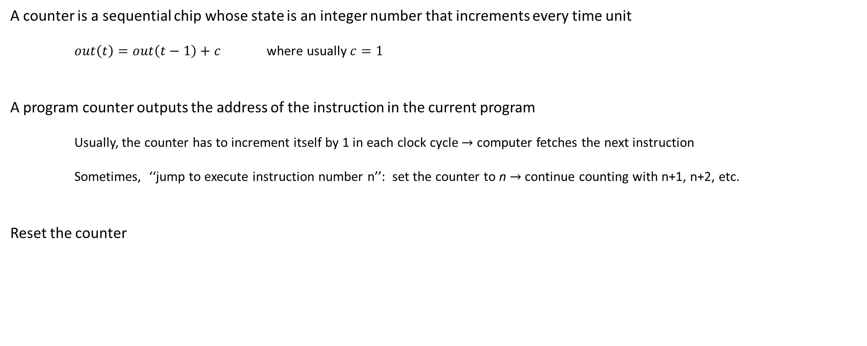
Counter
A counter is a sequential chip whose state is an integer number that increments every time unit
$out\left(t\right)=out\left(t−1\right)+c$ where usually $c=1$
A program counter outputs the address of the instruction in the current program
Usually, the counter has to increment itself by 1 in each clock cycle $→$ computer fetches the next instruction
Sometimes, ‘‘jump to execute instruction number n’’: set the counter to n $→$ continue counting with n+1, n+2, etc.
Reset the counter
Resetting to 0 restarts the program
Also, allow for decrementing instead of incrementing

Slide 72
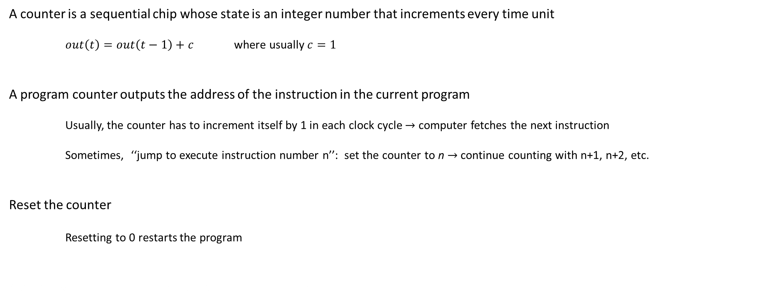
Counter
A counter is a sequential chip whose state is an integer number that increments every time unit
$out\left(t\right)=out\left(t−1\right)+c$ where usually $c=1$
A program counter outputs the address of the instruction in the current program
Usually, the counter has to increment itself by 1 in each clock cycle $→$ computer fetches the next instruction
Sometimes, ‘‘jump to execute instruction number n’’: set the counter to n $→$ continue counting with n+1, n+2, etc.
Reset the counter
Resetting to 0 restarts the program
Also, allow for decrementing instead of incrementing

Slide 73

Counter
A counter is a sequential chip whose state is an integer number that increments every time unit
$out\left(t\right)=out\left(t−1\right)+c$ where usually $c=1$
A program counter outputs the address of the instruction in the current program
Usually, the counter has to increment itself by 1 in each clock cycle $→$ computer fetches the next instruction
Sometimes, ‘‘jump to execute instruction number n’’: set the counter to n $→$ continue counting with n+1, n+2, etc.
Reset the counter
Resetting to 0 restarts the program
Also, allow for decrementing instead of incrementing

Slide 74
Counter
A counter chip = input/output logic of a standard register + combinatorial logic for adding a constant
The combinational logic
Computes the counting function
Puts the counter in the right operating mode, according to its 3 control bits: inc, load, reset
If inc = 1, the counter increments its state in every clock cycle
If load = 1 and input = d, the counter is initialized to counting base d (most of this logic was built in Ch 2)
If reset = 1, the counter resets to 0

Slide 75
Counter
A counter chip = input/output logic of a standard register + combinatorial logic for adding a constant
The combinational logic
Computes the counting function
Puts the counter in the right operating mode, according to its 3 control bits: inc, load, reset
If inc = 1, the counter increments its state in every clock cycle
If load = 1 and input = d, the counter is initialized to counting base d (most of this logic was built in Ch 2)
If reset = 1, the counter resets to 0

Slide 76
Counter
A counter chip = input/output logic of a standard register + combinatorial logic for adding a constant
The combinational logic
Computes the counting function
Puts the counter in the right operating mode, according to its 3 control bits: inc, load, reset
If inc = 1, the counter increments its state in every clock cycle
If load = 1 and input = d, the counter is initialized to counting base d (most of this logic was built in Ch 2)
If reset = 1, the counter resets to 0

Slide 77
Counter
A counter chip = input/output logic of a standard register + combinatorial logic for adding a constant
The combinational logic
Computes the counting function
Puts the counter in the right operating mode, according to its 3 control bits: inc, load, reset
If inc = 1, the counter increments its state in every clock cycle
If load = 1 and input = d, the counter is initialized to counting base d (most of this logic was built in Ch 2)
If reset = 1, the counter resets to 0

Slide 78
Counter
A counter chip = input/output logic of a standard register + combinatorial logic for adding a constant
The combinational logic
Computes the counting function
Puts the counter in the right operating mode, according to its 3 control bits: inc, load, reset
If inc = 1, the counter increments its state in every clock cycle
If load = 1 and input = d, the counter is initialized to counting base d (most of this logic was built in Ch 2)
If reset = 1, the counter resets to 0

Slide 79
Counter
A counter chip = input/output logic of a standard register + combinatorial logic for adding a constant
The combinational logic
Computes the counting function
Puts the counter in the right operating mode, according to its 3 control bits: inc, load, reset
If inc = 1, the counter increments its state in every clock cycle
If load = 1 and input = d, the counter is initialized to counting base d (most of this logic was built in Ch 2)
If reset = 1, the counter resets to 0

Slide 80


Counter
A counter chip = input/output logic of a standard register + combinatorial logic for adding a constant
The combinational logic
Computes the counting function
Puts the counter in the right operating mode, according to its 3 control bits: inc, load, reset
If inc = 1, the counter increments its state in every clock cycle
If load = 1 and input = d, the counter is initialized to counting base d (most of this logic was built in Ch 2)
If reset = 1, the counter resets to 0
Eg.
Time 22: in = 527 and out = 47
Time 23: reset = 1 $→$ Time 24: out = 0
out = 0 until inc = 1
Time 25: inc = 1 $→$ Time 26: out = 1
regular counting continues until load = 1
Time 29: load = 1 $→$ Time 30: out = in = 527
since still inc = 1, regular incrementing until inc = 0

Slide 81

Counter
A counter chip = input/output logic of a standard register + combinatorial logic for adding a constant
The combinational logic
Computes the counting function
Puts the counter in the right operating mode, according to its 3 control bits: inc, load, reset
If inc = 1, the counter increments its state in every clock cycle
If load = 1 and input = d, the counter is initialized to counting base d (most of this logic was built in Ch 2)
If reset = 1, the counter resets to 0
Eg.
Time 22: in = 527 and out = 47
Time 23: reset = 1 $→$ Time 24: out = 0
out = 0 until inc = 1
Time 25: inc = 1 $→$ Time 26: out = 1
regular counting continues until load = 1
Time 29: load = 1 $→$ Time 30: out = in = 527
since still inc = 1, regular incrementing until inc = 0

Slide 82

Counter
A counter chip = input/output logic of a standard register + combinatorial logic for adding a constant
The combinational logic
Computes the counting function
Puts the counter in the right operating mode, according to its 3 control bits: inc, load, reset
If inc = 1, the counter increments its state in every clock cycle
If load = 1 and input = d, the counter is initialized to counting base d (most of this logic was built in Ch 2)
If reset = 1, the counter resets to 0
Eg.
Time 22: in = 527 and out = 47
Time 23: reset = 1 $→$ Time 24: out = 0
out = 0 until inc = 1
Time 25: inc = 1 $→$ Time 26: out = 1
regular counting continues until load = 1
Time 29: load = 1 $→$ Time 30: out = in = 527
since still inc = 1, regular incrementing until inc = 0

Slide 83

Counter
A counter chip = input/output logic of a standard register + combinatorial logic for adding a constant
The combinational logic
Computes the counting function
Puts the counter in the right operating mode, according to its 3 control bits: inc, load, reset
If inc = 1, the counter increments its state in every clock cycle
If load = 1 and input = d, the counter is initialized to counting base d (most of this logic was built in Ch 2)
If reset = 1, the counter resets to 0
Eg.
Time 22: in = 527 and out = 47
Time 23: reset = 1 $→$ Time 24: out = 0
out = 0 until inc = 1
Time 25: inc = 1 $→$ Time 26: out = 1
regular counting continues until load = 1
Time 29: load = 1 $→$ Time 30: out = in = 527
since still inc = 1, regular incrementing until inc = 0

Slide 84

Counter
A counter chip = input/output logic of a standard register + combinatorial logic for adding a constant
The combinational logic
Computes the counting function
Puts the counter in the right operating mode, according to its 3 control bits: inc, load, reset
If inc = 1, the counter increments its state in every clock cycle
If load = 1 and input = d, the counter is initialized to counting base d (most of this logic was built in Ch 2)
If reset = 1, the counter resets to 0
Eg.
Time 22: in = 527 and out = 47
Time 23: reset = 1 $→$ Time 24: out = 0
out = 0 until inc = 1
Time 25: inc = 1 $→$ Time 26: out = 1
regular counting continues until load = 1
Time 29: load = 1 $→$ Time 30: out = in = 527
since still inc = 1, regular incrementing until inc = 0

Slide 85

Counter
A counter chip = input/output logic of a standard register + combinatorial logic for adding a constant
The combinational logic
Computes the counting function
Puts the counter in the right operating mode, according to its 3 control bits: inc, load, reset
If inc = 1, the counter increments its state in every clock cycle
If load = 1 and input = d, the counter is initialized to counting base d (most of this logic was built in Ch 2)
If reset = 1, the counter resets to 0
Eg.
Time 22: in = 527 and out = 47
Time 23: reset = 1 $→$ Time 24: out = 0
out = 0 until inc = 1
Time 25: inc = 1 $→$ Time 26: out = 1
regular counting continues until load = 1
Time 29: load = 1 $→$ Time 30: out = in = 527
since still inc = 1, regular incrementing until inc = 0

Slide 86

Counter
A counter chip = input/output logic of a standard register + combinatorial logic for adding a constant
The combinational logic
Computes the counting function
Puts the counter in the right operating mode, according to its 3 control bits: inc, load, reset
If inc = 1, the counter increments its state in every clock cycle
If load = 1 and input = d, the counter is initialized to counting base d (most of this logic was built in Ch 2)
If reset = 1, the counter resets to 0
Eg.
Time 22: in = 527 and out = 47
Time 23: reset = 1 $→$ Time 24: out = 0
out = 0 until inc = 1
Time 25: inc = 1 $→$ Time 26: out = 1
regular counting continues until load = 1
Time 29: load = 1 $→$ Time 30: out = in = 527
since still inc = 1, regular incrementing until inc = 0

Slide 87

Counter
A counter chip = input/output logic of a standard register + combinatorial logic for adding a constant
The combinational logic
Computes the counting function
Puts the counter in the right operating mode, according to its 3 control bits: inc, load, reset
If inc = 1, the counter increments its state in every clock cycle
If load = 1 and input = d, the counter is initialized to counting base d (most of this logic was built in Ch 2)
If reset = 1, the counter resets to 0
Eg.
Time 22: in = 527 and out = 47
Time 23: reset = 1 $→$ Time 24: out = 0
out = 0 until inc = 1
Time 25: inc = 1 $→$ Time 26: out = 1
regular counting continues until load = 1
Time 29: load = 1 $→$ Time 30: out = in = 527
since still inc = 1, regular incrementing until inc = 0

Slide 88

Counter
A counter chip = input/output logic of a standard register + combinatorial logic for adding a constant
The combinational logic
Computes the counting function
Puts the counter in the right operating mode, according to its 3 control bits: inc, load, reset
If inc = 1, the counter increments its state in every clock cycle
If load = 1 and input = d, the counter is initialized to counting base d (most of this logic was built in Ch 2)
If reset = 1, the counter resets to 0
Eg.
Time 22: in = 527 and out = 47
Time 23: reset = 1 $→$ Time 24: out = 0
out = 0 until inc = 1
Time 25: inc = 1 $→$ Time 26: out = 1
regular counting continues until load = 1
Time 29: load = 1 $→$ Time 30: out = in = 527
since still inc = 1, regular incrementing until inc = 0

Slide 89
Counter
Puts the counter in the right operating mode, according to its 3 control bits: inc, load, reset
If inc = 1, the counter increments its state in every clock cycle
If load = 1 and input = d, the counter is initialized to counting base d (most of this logic was built in Ch 2)
If reset = 1, the counter resets to 0
/**
* A 16-bit counter with load and reset control bits.
* if (reset[t] == 1) out[t+1] = 0
* else if (load[t] == 1) out[t+1] = in[t]
* else if (inc[t] == 1) out[t+1] = out[t] + 1 (integer addition)
* else out[t+1] = out[t]
*/
CHIP PC {
IN in[16],load,inc,reset;
OUT out[16];
PARTS:
Inc16(in=o, out=oinc);
Mux4Way16(a=oinc, b=in, c=false, d=false,
sel[0]=load, sel[1]=reset, out=o1);
Or8Way(in[0]=load, in[1]=inc, in[2]=reset,
in[3..7]=false, out=or);
Register(in=o1, load=or, out=o, out=out);
}

Slide 90


Perspective
In combinational chips (time neither modeled nor recognized) feedback loops are problematic
The output would depend on the input, which itself would depend on the output,
and thus the output would depend on itself
Sequential chips require feedback loops
Sequential chips = combinational + DFF sandwhich
DFFs have inherent time delay $→$ the output(t) does not depend on itself,
but rather on output(t-1) $→$ guarded against uncontrolled ‘‘data races’’
Their outputs change only during the transition between a clock cycle to the next,
and not within the cycle itself (in fact, they might be unstable states during clock cycles but we don’t care)

Slide 91

Perspective
In combinational chips (time neither modeled nor recognized) feedback loops are problematic
The output would depend on the input, which itself would depend on the output,
and thus the output would depend on itself
Sequential chips require feedback loops
Sequential chips = combinational + DFF sandwhich
DFFs have inherent time delay $→$ the output(t) does not depend on itself,
but rather on output(t-1) $→$ guarded against uncontrolled ‘‘data races’’
Their outputs change only during the transition between a clock cycle to the next,
and not within the cycle itself (in fact, they might be unstable states during clock cycles but we don’t care)

Slide 92

Perspective
In combinational chips (time neither modeled nor recognized) feedback loops are problematic
The output would depend on the input, which itself would depend on the output,
and thus the output would depend on itself
Sequential chips require feedback loops
Sequential chips = combinational + DFF sandwhich
DFFs have inherent time delay $→$ the output(t) does not depend on itself,
but rather on output(t-1) $→$ guarded against uncontrolled ‘‘data races’’
Their outputs change only during the transition between a clock cycle to the next,
and not within the cycle itself (in fact, they might be unstable states during clock cycles but we don’t care)

Slide 93

Perspective
In combinational chips (time neither modeled nor recognized) feedback loops are problematic
The output would depend on the input, which itself would depend on the output,
and thus the output would depend on itself
Sequential chips require feedback loops
Sequential chips = combinational + DFF sandwhich
DFFs have inherent time delay $→$ the output(t) does not depend on itself,
but rather on output(t-1) $→$ guarded against uncontrolled ‘‘data races’’
Their outputs change only during the transition between a clock cycle to the next,
and not within the cycle itself (in fact, they might be unstable states during clock cycles but we don’t care)

Slide 94

Perspective
In combinational chips (time neither modeled nor recognized) feedback loops are problematic
The output would depend on the input, which itself would depend on the output,
and thus the output would depend on itself
Sequential chips require feedback loops
Sequential chips = combinational + DFF sandwhich
DFFs have inherent time delay $→$ the output(t) does not depend on itself,
but rather on output(t-1) $→$ guarded against uncontrolled ‘‘data races’’
Their outputs change only during the transition between a clock cycle to the next,
and not within the cycle itself (in fact, they might be unstable states during clock cycles but we don’t care)

Slide 95

Perspective
In combinational chips (time neither modeled nor recognized) feedback loops are problematic
The output would depend on the input, which itself would depend on the output,
and thus the output would depend on itself
Sequential chips require feedback loops
Sequential chips = combinational + DFF sandwhich
DFFs have inherent time delay $→$ the output(t) does not depend on itself,
but rather on output(t-1) $→$ guarded against uncontrolled ‘‘data races’’
Their outputs change only during the transition between a clock cycle to the next,
and not within the cycle itself (in fact, they might be unstable states during clock cycles but we don’t care)

Slide 96
Perspective
‘Discretization’ of the sequential chips’ outputs synchronizes the overall computer architecture
Eg. You tell the ALU to compute x+y
The length of the computer cycle has to be slightly longer than time it takes to travel the longest distance between two chips

Slide 97
Perspective
‘Discretization’ of the sequential chips’ outputs synchronizes the overall computer architecture
Eg. You tell the ALU to compute x+y
The length of the computer cycle has to be slightly longer than time it takes to travel the longest distance between two chips

Slide 98
Perspective
‘Discretization’ of the sequential chips’ outputs synchronizes the overall computer architecture
Eg. You tell the ALU to compute x+y
The length of the computer cycle has to be slightly longer than time it takes to travel the longest distance between two chips
x is in nearby register
x
ALU
y
y is in a remote RAM register

Slide 99
Perspective
‘Discretization’ of the sequential chips’ outputs synchronizes the overall computer architecture
Eg. You tell the ALU to compute x+y
The length of the computer cycle has to be slightly longer than time it takes to travel the longest distance between two chips
x is in nearby register
x
x
ALU
y
y
input 1
y is in a remote RAM register
input 2
out | *#^( + %$@& | *#^( + %$@& | x + %$@& | x + %$@& | x + %$@& | x + %$@& | x + %$@& | x + y | x + y | x + y
input 1 | *#^( | *#^( | x | x | x | x | x | x | x | X
input 2 | %$@& | %$@& | %$@& | %$@& | %$@& | %$@& | %$@& | y | y | y
clock

Slide 100
Perspective
‘Discretization’ of the sequential chips’ outputs synchronizes the overall computer architecture
Eg. You tell the ALU to compute x+y
The length of the computer cycle has to be slightly longer than time it takes to travel the longest distance between two chips
x is in nearby register
x
x
ALU
ALU constantly computes whatever inputs it sees
ALU computes x + garbage until y arrives
y
y
*#^(
y is in a remote RAM register
%$@&
*#^( + %$@&
out | *#^( + %$@& | *#^( + %$@& | x + %$@& | x + %$@& | x + %$@& | x + %$@& | x + %$@& | x + y | x + y | x + y
input 1 | *#^( | *#^( | x | x | x | x | x | x | x | X
input 2 | %$@& | %$@& | %$@& | %$@& | %$@& | %$@& | %$@& | y | y | y
clock

Slide 101
Perspective
‘Discretization’ of the sequential chips’ outputs synchronizes the overall computer architecture
Eg. You tell the ALU to compute x+y
The length of the computer cycle has to be slightly longer than time it takes to travel the longest distance between two chips
x is in nearby register
x
x
ALU
y
ALU constantly computes whatever inputs it sees
ALU computes x + garbage until y arrives
y
*#^(
y is in a remote RAM register
%$@&
*#^( + %$@&
out | *#^( + %$@& | *#^( + %$@& | x + %$@& | x + %$@& | x + %$@& | x + %$@& | x + %$@& | x + y | x + y | x + y
input 1 | *#^( | *#^( | x | x | x | x | x | x | x | X
input 2 | %$@& | %$@& | %$@& | %$@& | %$@& | %$@& | %$@& | y | y | y
clock

Slide 102
Perspective
‘Discretization’ of the sequential chips’ outputs synchronizes the overall computer architecture
Eg. You tell the ALU to compute x+y
The length of the computer cycle has to be slightly longer than time it takes to travel the longest distance between two chips
x is in nearby register
x
y
ALU
x
ALU constantly computes whatever inputs it sees
ALU computes x + garbage until y arrives
y
physical constraints
(distance, resistance, interference, random noise, etc.)
*#^(
y is in a remote RAM register
%$@&
*#^( + %$@&
out | *#^( + %$@& | *#^( + %$@& | x + %$@& | x + %$@& | x + %$@& | x + %$@& | x + %$@& | x + y | x + y | x + y
input 1 | *#^( | *#^( | x | x | x | x | x | x | x | X
input 2 | %$@& | %$@& | %$@& | %$@& | %$@& | %$@& | %$@& | y | y | y
clock

Slide 103
Perspective
‘Discretization’ of the sequential chips’ outputs synchronizes the overall computer architecture
Eg. You tell the ALU to compute x+y
The length of the computer cycle has to be slightly longer than time it takes to travel the longest distance between two chips
x is in nearby register
x
y
ALU
signal from x arrives before y
ALU constantly computes whatever inputs it sees
ALU computes x + garbage until y arrives
y
physical constraints
(distance, resistance, interference, random noise, etc.)
x
*#^(
y is in a remote RAM register
%$@&
*#^( + %$@&
out | *#^( + %$@& | *#^( + %$@& | x + %$@& | x + %$@& | x + %$@& | x + %$@& | x + %$@& | x + y | x + y | x + y
input 1 | *#^( | *#^( | x | x | x | x | x | x | x | X
input 2 | %$@& | %$@& | %$@& | %$@& | %$@& | %$@& | %$@& | y | y | y
clock

Slide 104
Perspective
‘Discretization’ of the sequential chips’ outputs synchronizes the overall computer architecture
Eg. You tell the ALU to compute x+y
The length of the computer cycle has to be slightly longer than time it takes to travel the longest distance between two chips
x is in nearby register
x
y
ALU
signal from x arrives before y
ALU constantly computes whatever inputs it sees
ALU computes x + garbage until y arrives
y
physical constraints
(distance, resistance, interference, random noise, etc.)
x
x
y is in a remote RAM register
%$@&
*#^( + %$@&
out | *#^( + %$@& | *#^( + %$@& | x + %$@& | x + %$@& | x + %$@& | x + %$@& | x + %$@& | x + y | x + y | x + y
input 1 | *#^( | *#^( | x | x | x | x | x | x | x | X
input 2 | %$@& | %$@& | %$@& | %$@& | %$@& | %$@& | %$@& | y | y | y
clock

Slide 105
Perspective
‘Discretization’ of the sequential chips’ outputs synchronizes the overall computer architecture
Eg. You tell the ALU to compute x+y
The length of the computer cycle has to be slightly longer than time it takes to travel the longest distance between two chips
x is in nearby register
x
y
ALU
signal from x arrives before y
ALU constantly computes whatever inputs it sees
ALU computes x + garbage until y arrives
y
physical constraints
(distance, resistance, interference, random noise, etc.)
x
x
y is in a remote RAM register
%$@&
x + %$@&
out | *#^( + %$@& | *#^( + %$@& | x + %$@& | x + %$@& | x + %$@& | x + %$@& | x + %$@& | x + y | x + y | x + y
input 1 | *#^( | *#^( | x | x | x | x | x | x | x | X
input 2 | %$@& | %$@& | %$@& | %$@& | %$@& | %$@& | %$@& | y | y | y
clock

Slide 106
Perspective
‘Discretization’ of the sequential chips’ outputs synchronizes the overall computer architecture
Eg. You tell the ALU to compute x+y
The length of the computer cycle has to be slightly longer than time it takes to travel the longest distance between two chips
x is in nearby register
x
y
ALU
signal from x arrives before y
ALU constantly computes whatever inputs it sees
ALU computes x + garbage until y arrives
y
physical constraints
(distance, resistance, interference, random noise, etc.)
x
x
y is in a remote RAM register
%$@&
x + %$@&
out | *#^( + %$@& | *#^( + %$@& | x + %$@& | x + %$@& | x + %$@& | x + %$@& | x + %$@& | x + y | x + y | x + y
input 1 | *#^( | *#^( | x | x | x | x | x | x | x | X
input 2 | %$@& | %$@& | %$@& | %$@& | %$@& | %$@& | %$@& | y | y | y
clock

Slide 107
Perspective
‘Discretization’ of the sequential chips’ outputs synchronizes the overall computer architecture
Eg. You tell the ALU to compute x+y
The length of the computer cycle has to be slightly longer than time it takes to travel the longest distance between two chips
x is in nearby register
x
ALU
y
signal from x arrives before y
ALU constantly computes whatever inputs it sees
ALU computes x + garbage until y arrives
y
physical constraints
(distance, resistance, interference, random noise, etc.)
x
x
y is in a remote RAM register
%$@&
x + %$@&
out | *#^( + %$@& | *#^( + %$@& | x + %$@& | x + %$@& | x + %$@& | x + %$@& | x + %$@& | x + %$@& | x + y | x + y
input 1 | *#^( | *#^( | x | x | x | x | x | x | x | X
input 2 | %$@& | %$@& | %$@& | %$@& | %$@& | %$@& | %$@& | %$@& | y | y
clock

Slide 108
Perspective
‘Discretization’ of the sequential chips’ outputs synchronizes the overall computer architecture
Eg. You tell the ALU to compute x+y
The length of the computer cycle has to be slightly longer than time it takes to travel the longest distance between two chips
x is in nearby register
x
ALU
signal from x arrives before y
ALU constantly computes whatever inputs it sees
ALU computes x + garbage until y arrives
y
physical constraints
(distance, resistance, interference, random noise, etc.)
x
x
y
x + %$@&
y is in a remote RAM register
%$@&
out | *#^( + %$@& | *#^( + %$@& | x + %$@& | x + %$@& | x + %$@& | x + %$@& | x + %$@& | x + %$@& | x + y | x + y
input 1 | *#^( | *#^( | x | x | x | x | x | x | x | X
input 2 | %$@& | %$@& | %$@& | %$@& | %$@& | %$@& | %$@& | %$@& | y | y
clock

Slide 109
Perspective
‘Discretization’ of the sequential chips’ outputs synchronizes the overall computer architecture
Eg. You tell the ALU to compute x+y
The length of the computer cycle has to be slightly longer than time it takes to travel the longest distance between two chips
x is in nearby register
x
ALU
signal from x arrives before y
ALU constantly computes whatever inputs it sees
ALU computes x + garbage until y arrives
y
physical constraints
(distance, resistance, interference, random noise, etc.)
x
x
y
x + %$@&
y is in a remote RAM register
y
out | *#^( + %$@& | *#^( + %$@& | x + %$@& | x + %$@& | x + %$@& | x + %$@& | x + %$@& | x + %$@& | x + y | x + y
input 1 | *#^( | *#^( | x | x | x | x | x | x | x | X
input 2 | %$@& | %$@& | %$@& | %$@& | %$@& | %$@& | %$@& | %$@& | y | y
clock

Slide 110
Perspective
‘Discretization’ of the sequential chips’ outputs synchronizes the overall computer architecture
Eg. You tell the ALU to compute x+y
The length of the computer cycle has to be slightly longer than time it takes to travel the longest distance between two chips
x is in nearby register
x
ALU
signal from x arrives before y
ALU constantly computes whatever inputs it sees
ALU computes x + garbage until y arrives
y
physical constraints
(distance, resistance, interference, random noise, etc.)
x
x
y
x + y
y is in a remote RAM register
y
out | *#^( + %$@& | *#^( + %$@& | x + %$@& | x + %$@& | x + %$@& | x + %$@& | x + %$@& | x + %$@& | x + y | x + y
input 1 | *#^( | *#^( | x | x | x | x | x | x | x | X
input 2 | %$@& | %$@& | %$@& | %$@& | %$@& | %$@& | %$@& | %$@& | y | y
clock

Slide 111
Perspective
‘Discretization’ of the sequential chips’ outputs synchronizes the overall computer architecture
Eg. You tell the ALU to compute x+y
The length of the computer cycle has to be slightly longer than time it takes to travel the longest distance between two chips
x is in nearby register
x
ALU
signal from x arrives before y
ALU constantly computes whatever inputs it sees
ALU computes x + garbage until y arrives
y
physical constraints
(distance, resistance, interference, random noise, etc.)
x
x
y
x + y
y is in a remote RAM register
y
out | *#^( + %$@& | *#^( + %$@& | x + %$@& | x + %$@& | x + %$@& | x + %$@& | x + %$@& | x + %$@& | x + y | x + y
input 1 | *#^( | *#^( | x | x | x | x | x | x | x | X
input 2 | %$@& | %$@& | %$@& | %$@& | %$@& | %$@& | %$@& | %$@& | y | y
clock

